Slide 1
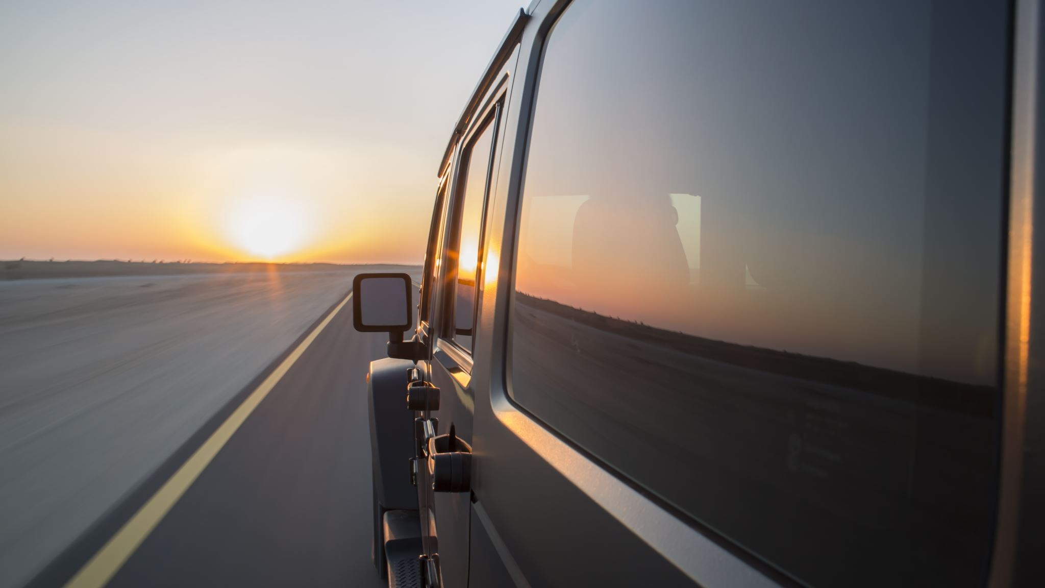
Driving into the Sunset
By: Grant Thompson, Arun Chakraborty, Shalin Shekhar

Slide 2
Description of the dataset
We are exploring a dataset of U.S. traffic accidents collected from February 2016 to March 2019. There are 2.25 million accident records in the dataset, covering 49 states in the US.
Key datapoints provided for each accident:
Latitude and Longitude
Accident Date and Time
Weather Conditions
State and time zone
Road name and description of accident
Source: https://www.kaggle.com/sobhanmoosavi/us-accidents

Slide 3
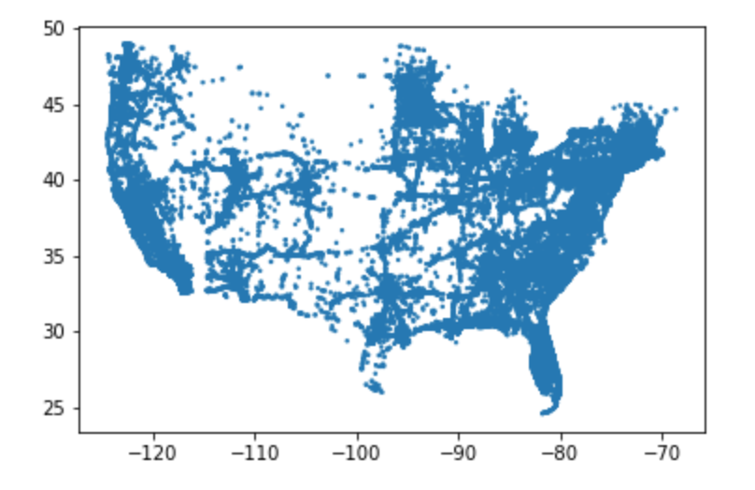
Scatterplot of each accident (lat and lng)

Slide 4
Questions we wanted to answer:
Is there an increase in accidents driving westbound during sunset? Said another way, does the glare from the setting sun increase the risk of getting in an accident when you are driving west?
Are there more (or less) car accidents during rush hour?
On what days of the week are accidents the greatest?
What states have the highest rate of accidents?
Are there more car accidents during poor weather conditions?

Slide 5
Summary Findings
We could not conclude that driving west during sunset caused accidents.
We found there are more accidents during rush hour than at other times of the day.
More accidents occur during the week than the weekend. No meaningful difference in days of the week.
It was difficult to tell how much of an impact weather had on accidents.

Slide 6
Contents 1. Accidents due to sunset glare for westbound traffic
2. Accidents during rush hour
3. Accidents due to weather condition
4. Accidents by state
5. Accidents for weekday vs weekends

Slide 7
Setting Sun Analysis
Null Hypothesis – The number of accidents leading up to sunset is the same regardless of the direction someone is driving (North, South, East, or West).
Hypothesis - We believe there will be greater number of accidents going westbound vs the other directions due to the glare from the sun impacting driver visibility.

Slide 8
Data exploration and cleanup For the sunset glare analysis:
Started with 2.25 million accident reports and parsed the data to include only interstate accidents.
Then we split the data into four groups for each direction (northbound, southbound, eastbound, westbound)
We used the latitude, longitude and accident date to get the sunset time using the suntime python library
This gives the sunset time local to the machine (in this case, PST)
We converted the sunset time to UTC and then converted it to the local time of the accident timezone with the help of pytz python library
We filtered all data to include only traffic accidents occurring within 30 minutes of sunset using datetime, dateparser, time packages
We binned the data based on direction (N/S/E/W) and time delta (sunset time - accident time) prior to sunset('0to<5', '5to<10', '10to<15', '15to<20', '20to<25', '25to<30’ mins)
Additionally we looked at westbound traffic accident prevalence for the time period of 2 hours prior to sunset until 2 hours after sunset
Installations:
suntime, pytz 2005k

Slide 9
Sunset glare for westbound traffic Summary of findings:
Observations:
The total accidents were higher for N/S compared to W/E for interstates
we didn’t see an increase in the percentage of accidents for westbound traffic 1hour or 30 minutes prior to sunset compared to other directions
We were not able to reject the null hypothesis (pvalue=0.9993905395344729)

Slide 10
Summary of findings (cont)
 | 0to<5 | 5to<10 | 10to<15 | 15to<20 | 20to<25 | 25to<30
Direction
E | 175 | 186 | 193 | 189 | 197 | 181
N | 277 | 311 | 267 | 270 | 282 | 315
S | 215 | 225 | 252 | 213 | 234 | 233
W | 173 | 163 | 182 | 158 | 175 | 200
Observations:
The number accidents are highest at 25 to < 30 min bin for westbound
Accident counts are higher for north and south bound during that time delta prior to sunset
The above is derived from Independent (Two Sample) T-Test of accidents close to sunset for westbound vs east north, south and ANOVA between 4 directions accident count 30 mins prior to sunset which can be found in our jupyter notebook analysis (pvalue=1.4755919050026132e-10)

Slide 11
Summary of findings (cont)

Slide 12
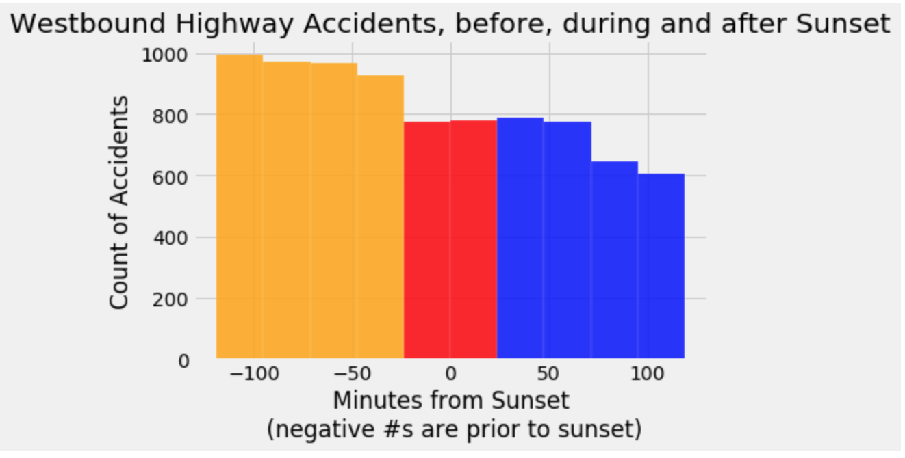

Slide 13
Rush Hour Analysis
Null hypothesis is there is no difference in accident count between rush vs non rush of work hours or rest of the hours of day.
Our hypothesis is that accident counts are greater during morning + evening rush hour compared to rest of work hours

Slide 14
Data exploration & Clean Up – Rush Hour
For rush hour analysis we put the traffic data into three bins:
Rush hour: 7am to 10am + 4pm to 7pm
Rest of the workday: 10am to 4pm
Rest of the day/night: 7pm to 7am

Slide 15
Rush Hour Summary of findings
Observations:
Number of accident is higher for the rush hour ( 7am – 10m) + (4pm – 7pm) compared to non rush work hours (10am – 4 pm) or rest of the day ( 7 pm – 7 am)
An Independent (Two Sample) T-Test analysis was done for the total rush hour vs non rush hour for the work hours (pvalue=3.828605755116189e-173)

Slide 16
Weather Condition
It was difficult to discern how weather impacts traffic accidents. Most accidents occur when weather conditions are good.

Slide 17
Data exploration and cleanup – Weather conditions
For weather condition analysis:
we had to clean up the weather condition data as it was all over the place (i.e. lightly snowy, freezing drizzle, volcanic ash, etc) into four bins: dry conditions, rainy conditions, freezing conditions, foggy conditions.

Slide 18
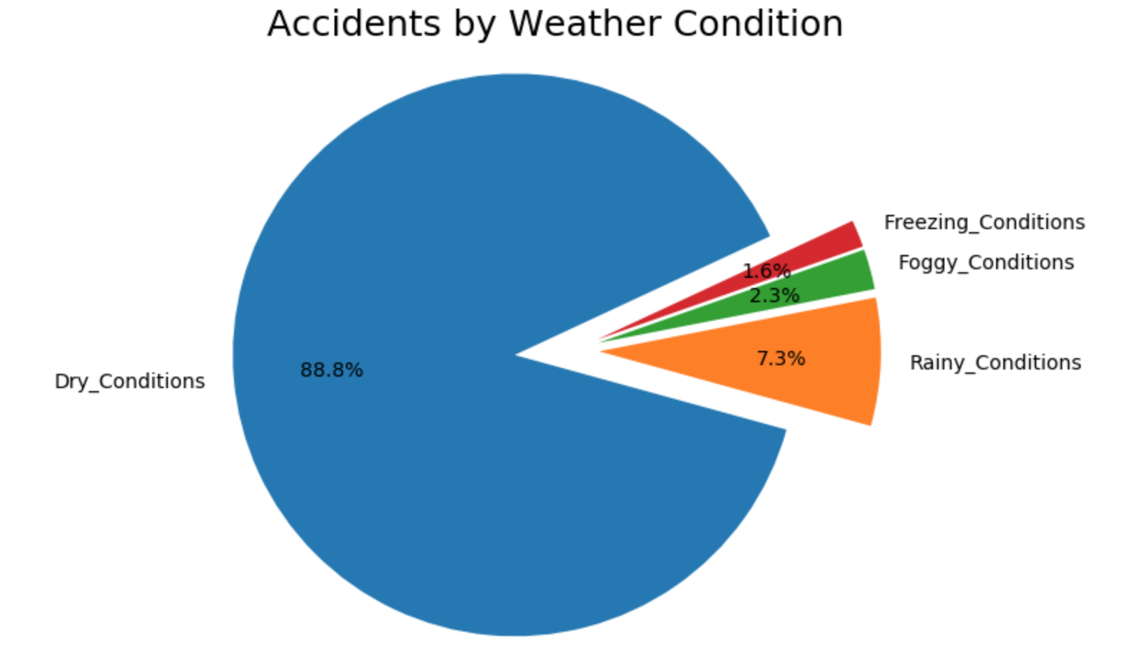

Slide 19
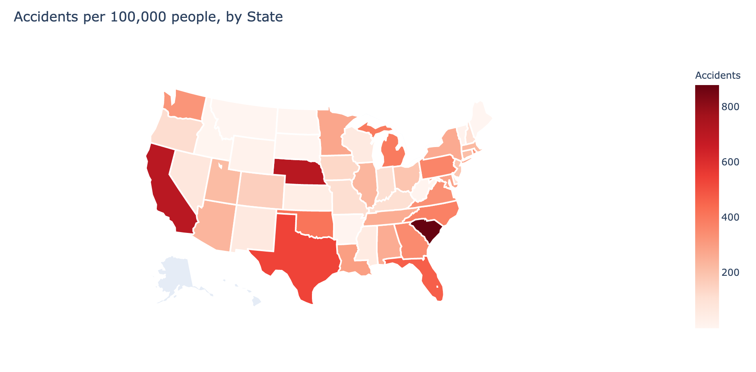

Slide 20
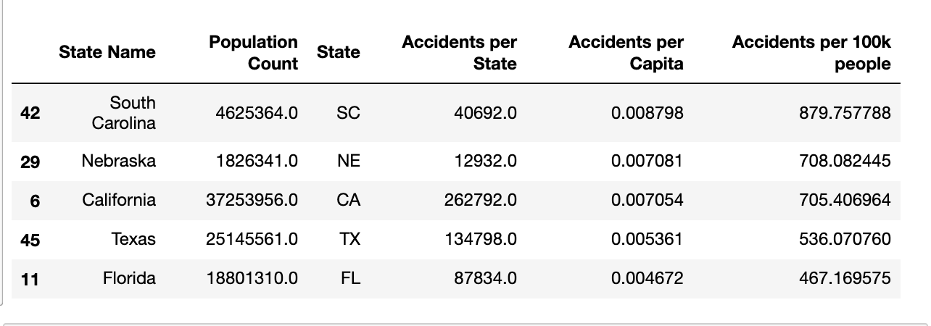
Highest rate of accidents per capita

Slide 21
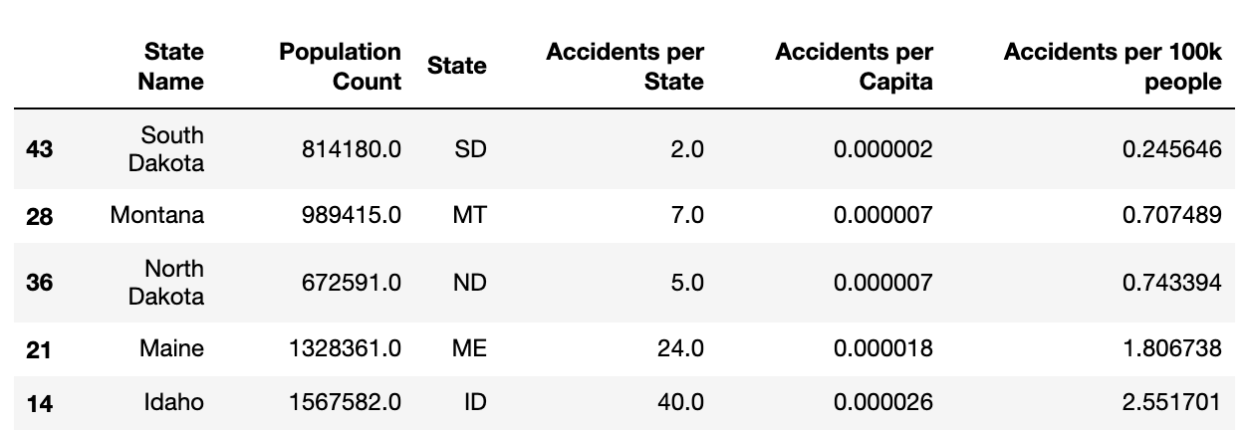
Lowest rate of accidents per capita

Slide 22
Our Analysis Strategy
To do our analysis, we used:
Bar Chart
Pie Chart
Scatter plot
Histogram
gmap
ANOVA
Independent (Two Sample) T-Test

Slide 23
Challenges
the data set was about over 200,000 after parsing only the interstates for for each direction, to calculate the sunset time for each of the accident based on the latitude, longitude and date tried the https://sunrise-sunset.org/api, since each request was an api call, the process was slow and there was connection issues with the server and the program will stop after 200 requests.
Despite adding few changes :
‘verify = false’
try, except block for the ssl connection errors
add ‘sleep’ of 1 second
Didn’t fix the connection issues after few thousand requests, had to move to ‘suntime’ python library which was considerably faster but gives the time based on the local time of the machine so had to do some conversation to utc -> accident location’s sunset time based on timezone.

Slide 24
Challenges (cont.)
In order to make further insights into this data, we would need traffic distribution data. For example, accidents are lower on the weekend, but there are fewer cars on the road. It would be interesting to be able to determine the rate of accidents per 100 cars on the road. Another example is the weather-related data. Most accidents occur when the weather is clear, but that’s simply because most of the time the weather is clear.

Slide 25
Things we would have liked to try if time permitted :
Check for multiple accident data for accidents in U.S from various other sources, and try the same analysis
Find a python module that can calculate the exact direction/angle of the sunset so we can further narrow down the direction for westbound accidents for further accuracy.

Slide 26


